Slide 1





2026 NEW ACTIVITY DIRECTORS TRAINING
ABOUT ASAA
ABOUT AKIAAA
GAME DAY & TRAVEL
PARENT MEETINGS
COACHES MEETINGS

Slide 2


Slide 3
ASAA has employees… Billy Strickland, Executive Director, Sandi Wagner, Associate Director
billy@asaa.org
907-545-4054
responsible for ASAA operations, staff, finances, eligibility, waivers, and ASAA board relations. He is Alaska’s representative on the National Federation Council and currently is on the NFHS Board of Directors. Additionally, Billy serves on the ASAA Sports Medicine Advisory Committee.
sandi@asaa.org
907-723-3421
responsible for historical data, Alaska High School Hall of Fame, awards and serves on the Sports Medicine Advisory Committee. She also provides support for the School Activities Reporting System (SARS) She is the NIAAA Liaison and also coordinates Tennis, 3A/4A Volleyball, Mix Six/2A Volleyball, Nordic Ski, Cheer, Soccer and Softball. Sandi also coordinates ASAA trainings for coaches and admin.

Slide 4
Staff Roles
Deanna Montagna - Office Manager and Director of Fine Arts…manages office operations, assists Associate Directors and works with the Executive Director in communication to schools. Deanna provides support for the School Activities Reporting System (SARS) and is also responsible for All State Art Competition, DDF and World Language Declamation Competition. She is the secretary for the ASAA Board of Directors meetings and is charged with maintaining the minutes.
Kathleen Navarre -Associate Director- coordinates Cross Country, Flag Football, Swim & Dive, Wrestling, Basketball, Track & Field, Baseball and assists in other ASAA programs. Kathleen consults with Special Olympics Alaska on the development and promotion of Unified Sports.
Brian Hosken -Associate Director…responsible for officials and coaches’ certification, state championship officials' selection and ejections, grant writing and administrating. He also coordinates Football and Hockey.
Kari McFeron – Receptionist…assist with front office duties

Slide 5
ASAA Contractors and Partners
Colin McDonald - TPG (Marketing & Development)
Barb Carroll - Music
Jeanie Farley – Business Manager
Kassandra Mirosh – Student Government
Rapi Sotoa – TPG/ASAA (Marketing, Social Media, Esports)

Slide 6

ASAA Structure
….In 1986, the Department of Education eliminated funding for ASAA. The Board of Control voted to incorporate as a 501(c)(3) non-profit corporation, beginning July 1, 1987. Because of ongoing jurisdictional issues between the Association and the State of Alaska, both entities sought a legal resolution. This resulted in the 1995 repeal of the Legislative Statue that had placed ASAA under the Department of Education.

Slide 7
ASAA Leadership…
The Alaska School Activities Association is governed by a Board of Directors. The Board of Directors consists of the elected representative from Region 1, Region 2, Region 3, Region 4, Region 5 and Region 6 and one representative each from the Association of Alaska School Boards, the Alaska Superintendents Association, and one non-voting ex-officio member representing the Alaska Association of Student Governments.
The Board of Directors shall appoint an Executive Director, prescribe duties and fix the compensation. This person shall serve at the pleasure of the Board. The Board may appoint other officers, agents and employees and prescribe their duties and compensation.

Slide 8
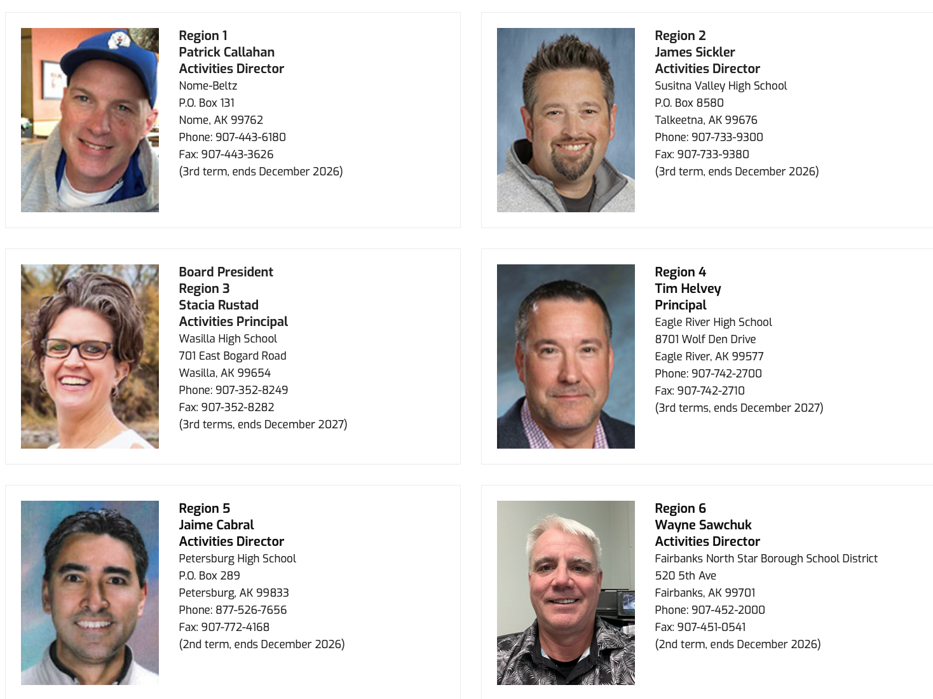
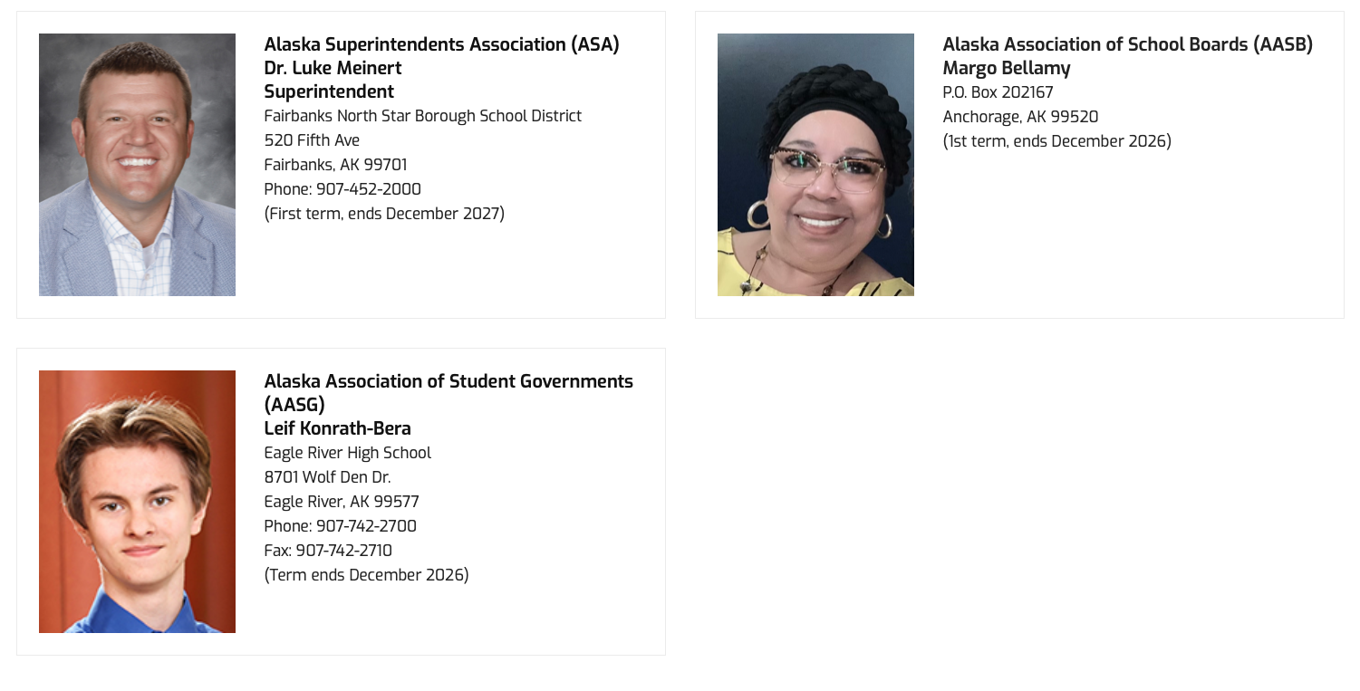
Current ASAA Board of Directors
Board members serve two-year terms and may serve up to three consecutive terms.
The Alaska Association of Student Governments is invited to appoint one non-voting ex-officio representative to the Board with terms not to exceed two years.

Slide 9
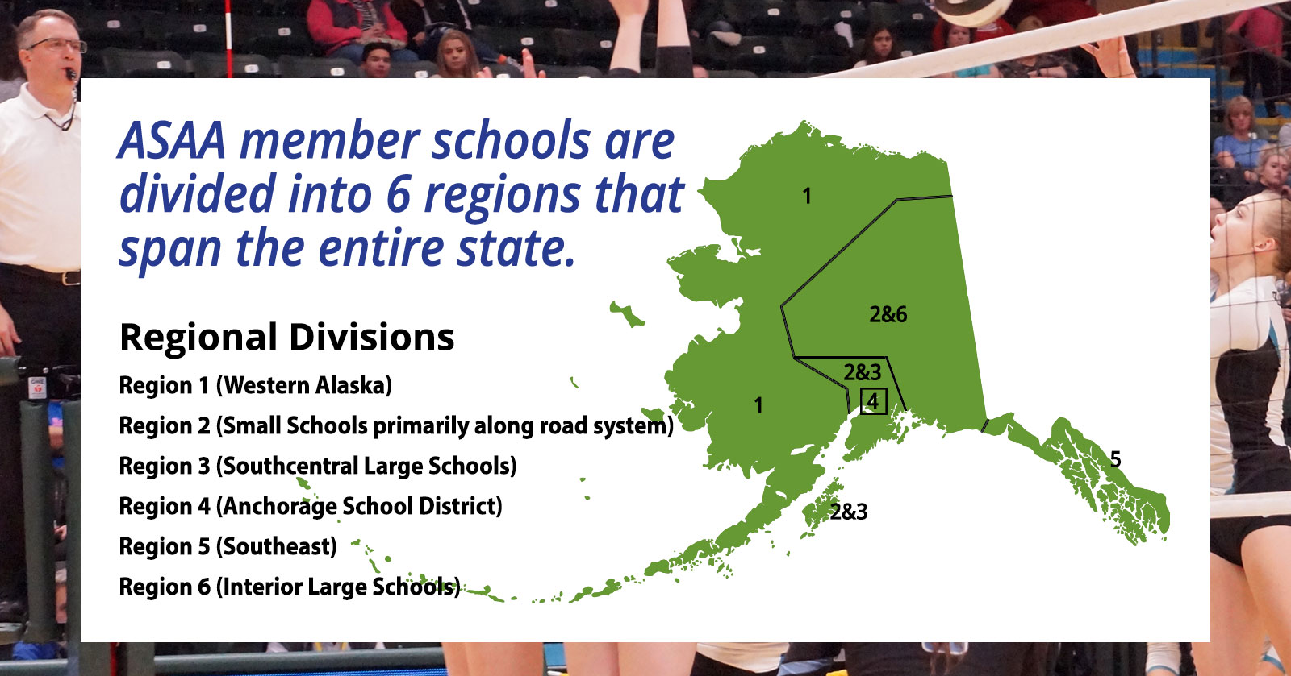

Slide 10
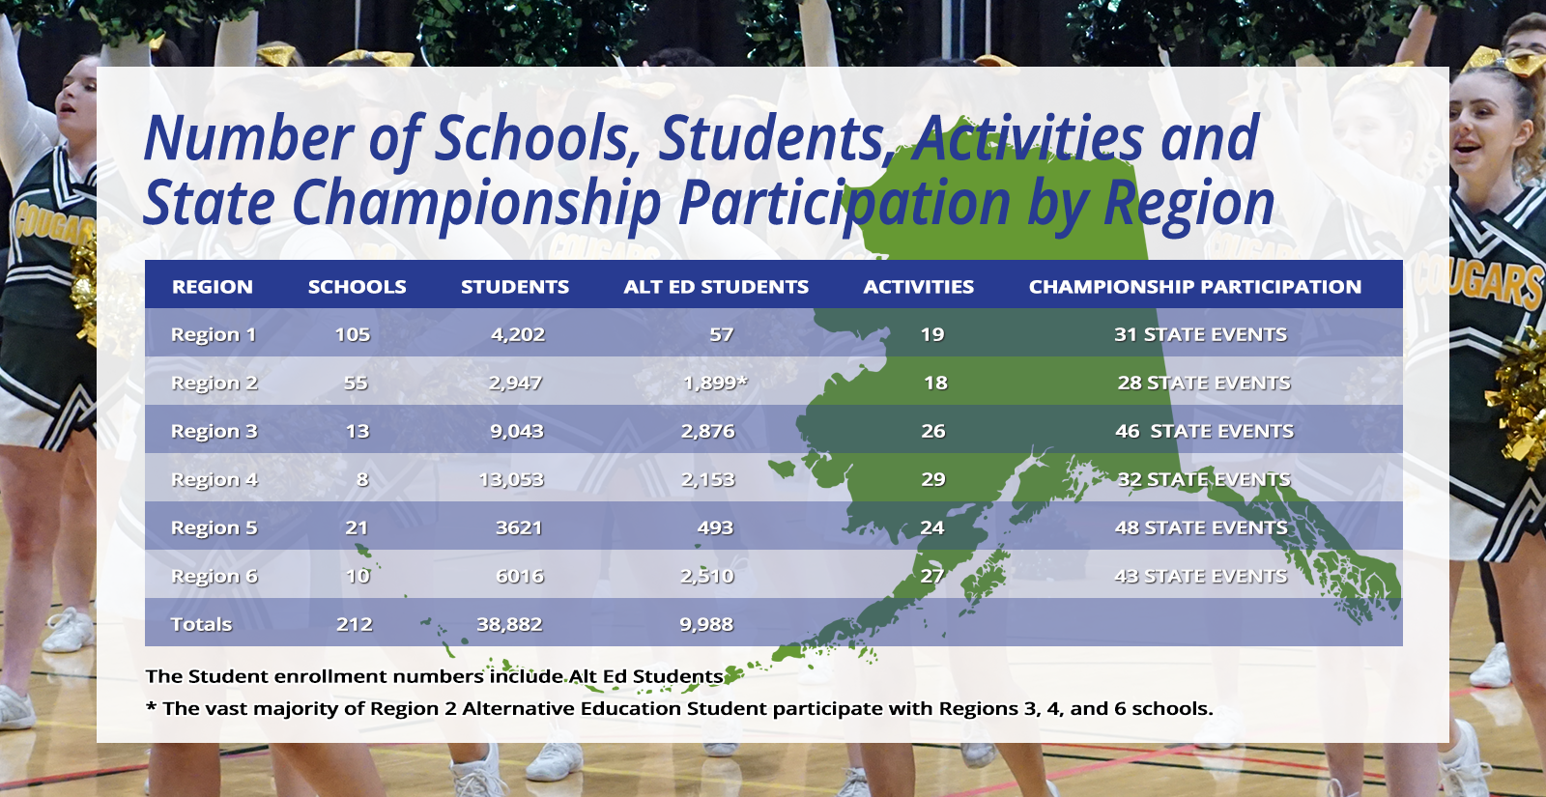

Slide 11

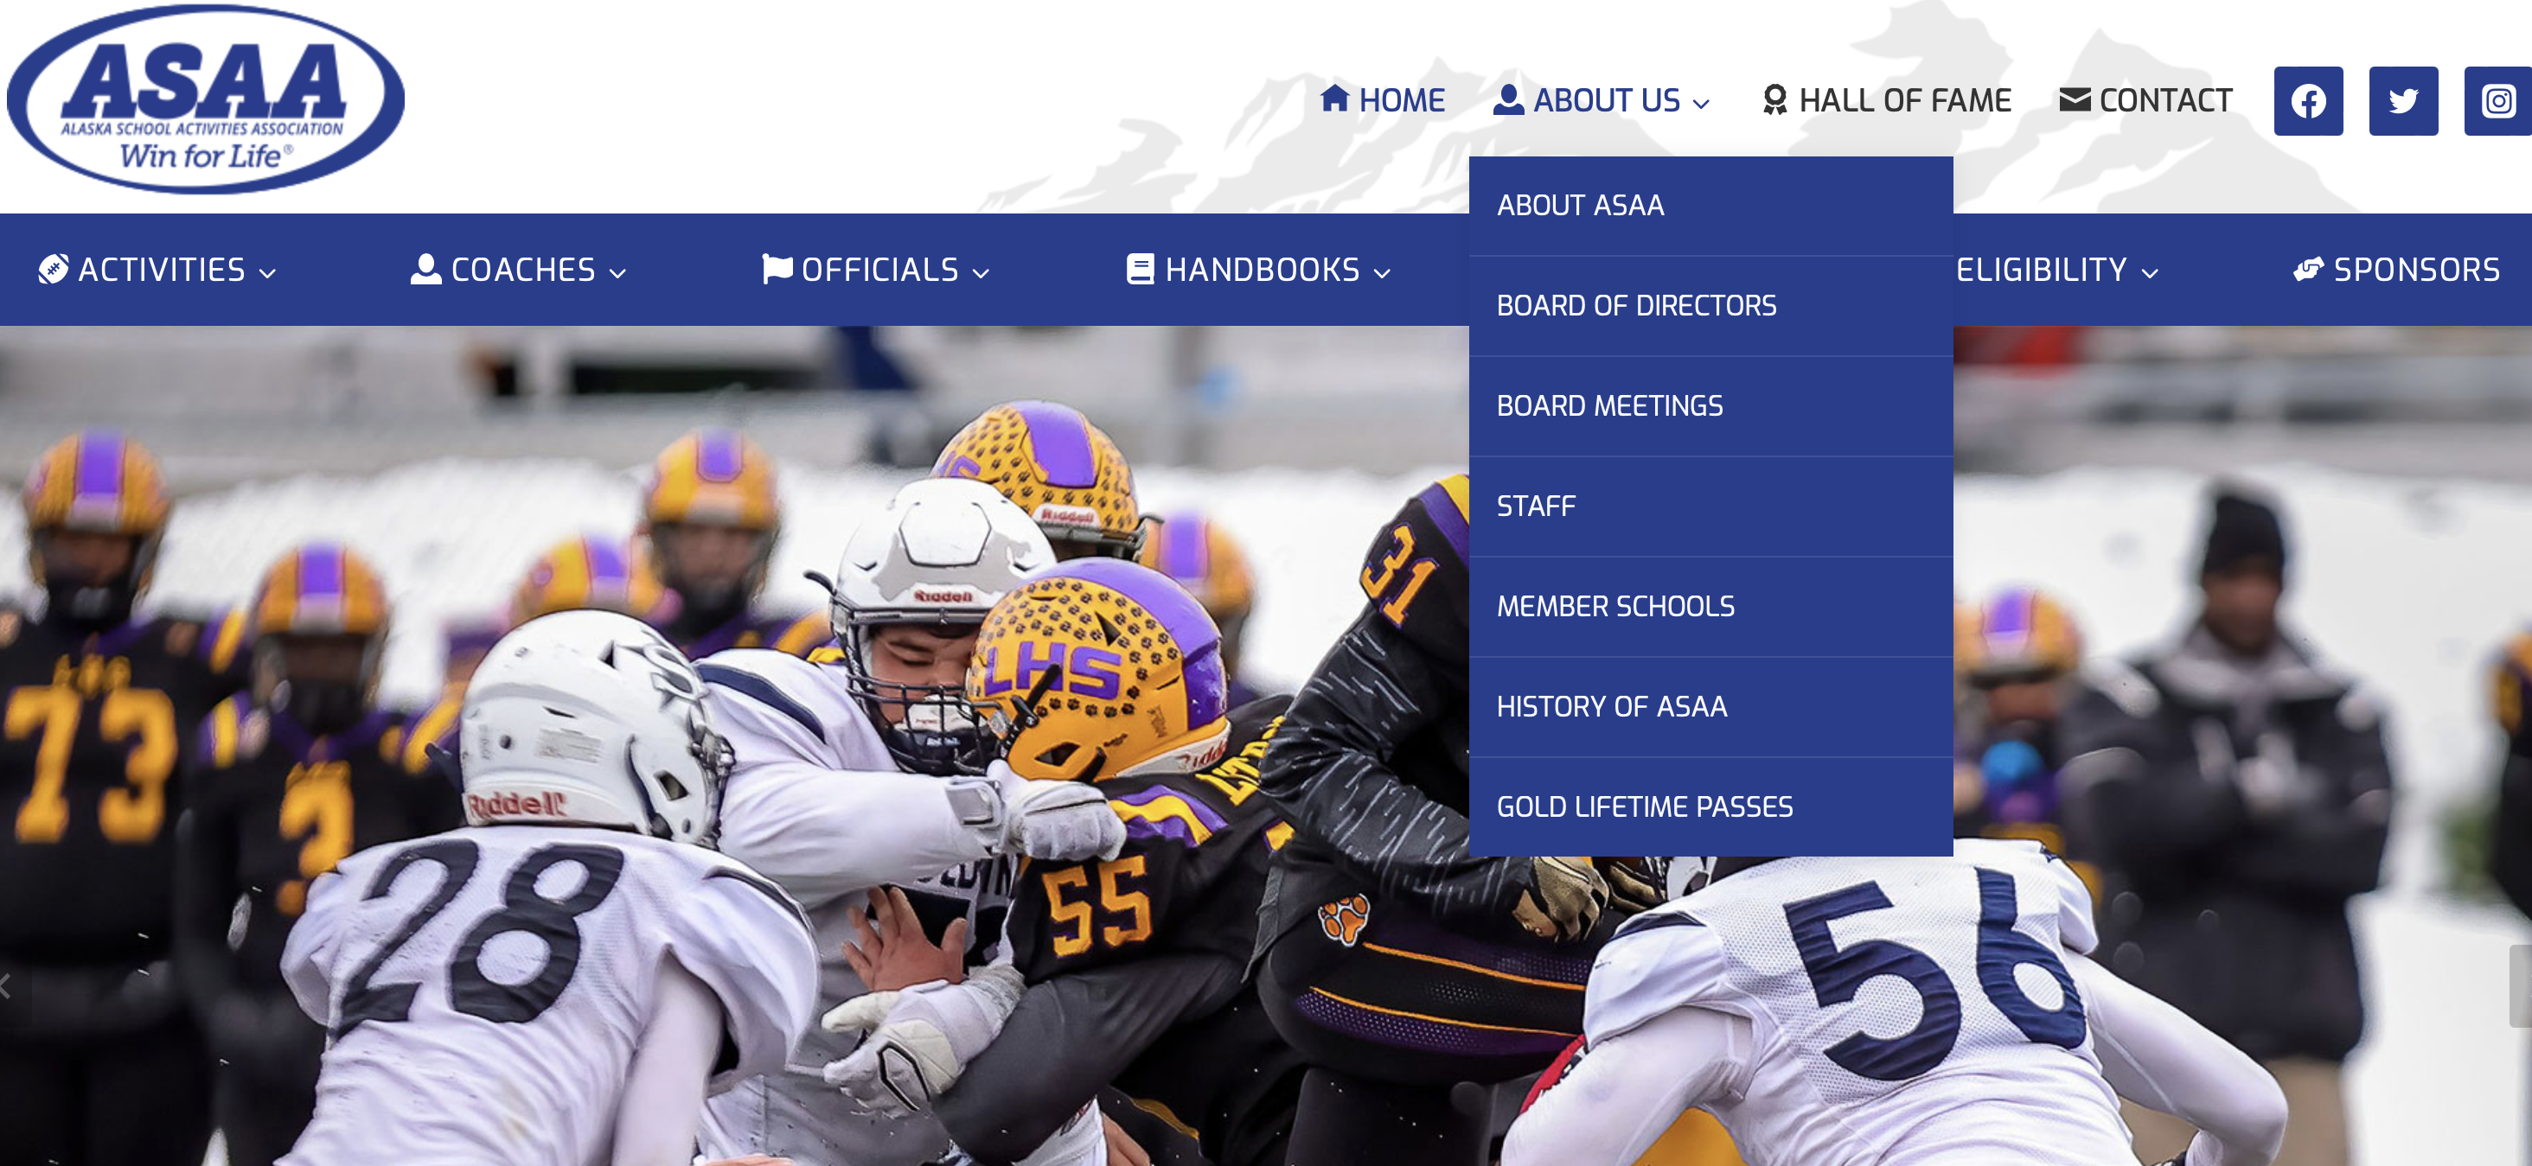
Board Agenda, Packet & Minutes
I will typically post the Meeting Agenda about three weeks prior to the meetings.
I will typically send out the Board packet to the Board Members about two weeks prior to the meetings.
Unadopted Minutes are usually posted within a week of the Board meeting being concluded.

Slide 12
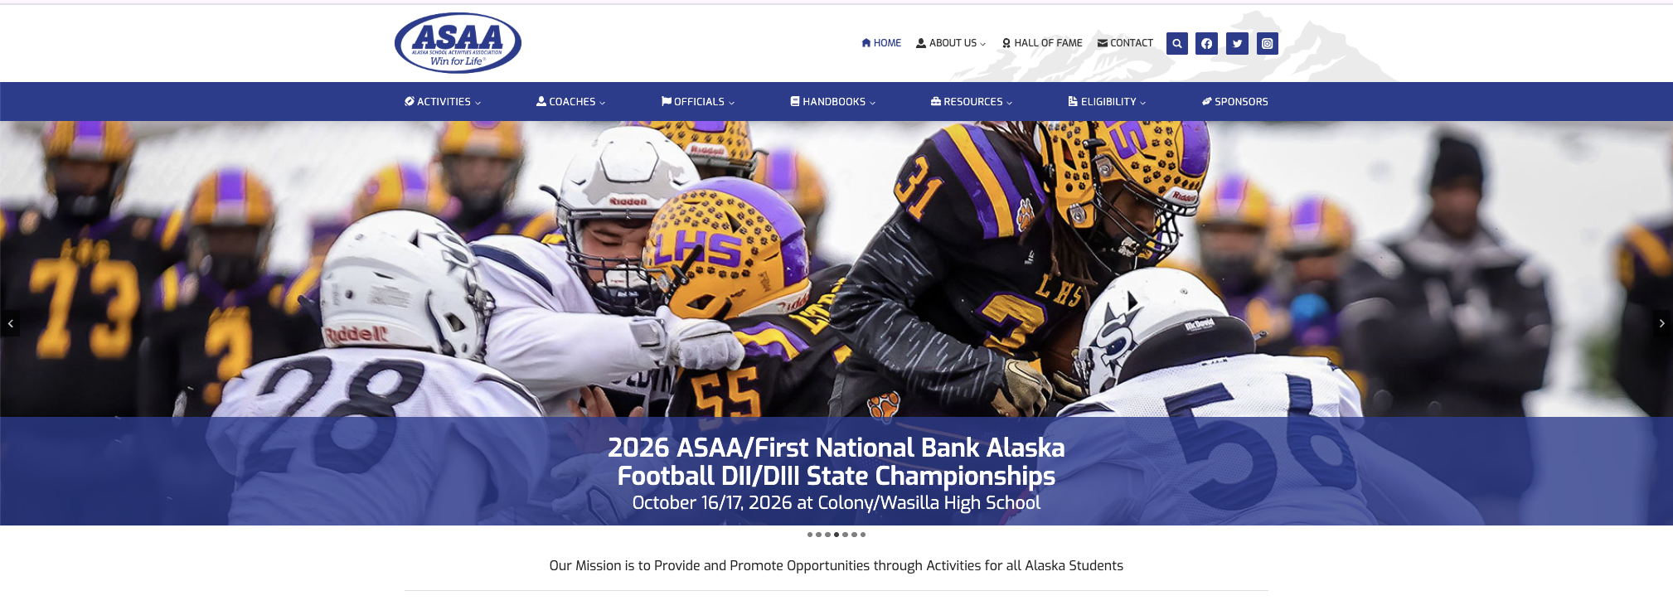
ASAA Website----asaa.org

Slide 13
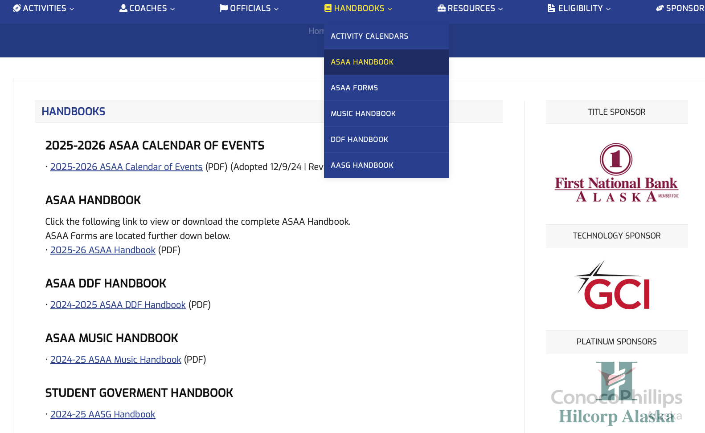
ASAA Handbook
Found on the Handbook Tab…will be updated throughout the year

Slide 14
CALENDAR OF EVENTS
Approved each year at the December Board Meeting.
First Practice Date
First Contest Date
Last Contest Date
State Championship Dates and Location
Board of Directors Meetings

Slide 15
All ASAA Bylaws and Policies are approved and can only be changed by the ASAA Board of Directors
While they are all important, I would suggest making sure you know then following rules as soon as possible:
  Student Eligibility Rules
  Practice Rules
  Qualifications of Coaches and Advisors
  Transfer Rules
  How a student establishes a “school of eligibility”
  Out of Season Contact Rules
  Scrimmages
  How the waiver system works
  Alternative education
  Reporting Schedules and Scores
  Cooperative School Programs

Slide 16
Self-Reporting-Revised
Self-Reporting: A member school shall report its own violation for any infraction of the Bylaws or policies. Some degree of leniency, including waiver of minimum mandatory financial and other penalties, may be made in self-reporting cases since the majority of such infractions may not otherwise come to light. Game or contest forfeitures as stated in Article 12, Section 1, shall not be waived in cases of self-reporting, unless the school was given incorrect information from the student, parent or guardian. In these instances, the association may waive the game or contest forfeitures.

Slide 17
BEWARE
ASAA’s rules are the minimal ones all our member schools must follow. It is very common for a school district to set higher standards, so make sure you know if your district does.

Slide 18
https://akiaaa.org

Slide 19
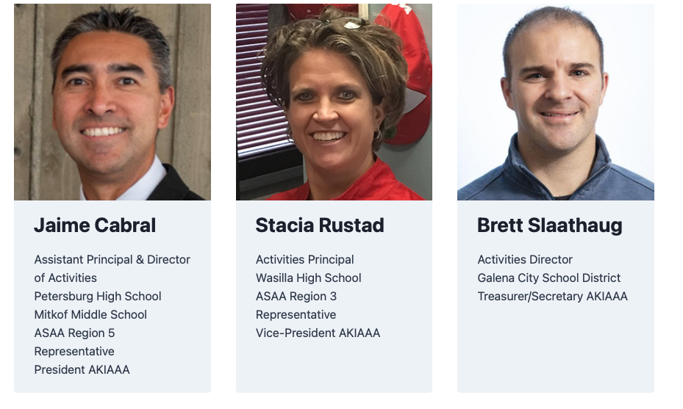
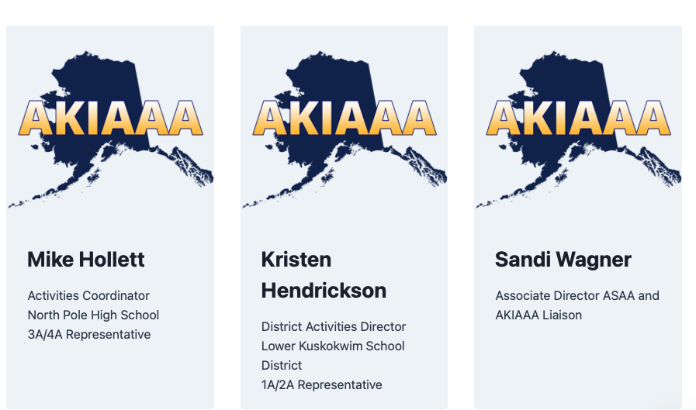
Executive Board

Slide 20
AKIAAA
The Alaska Interscholastic Activity Administrators Association is a voluntary association of public and Private high Schools which was established by and is responsible to its members. We are committed to improving the governance of activities within the state of Alaska in cooperation with the Alaska Schools Activities Association (ASAA).
The AKIAAA provides activity administrators with the knowledge and skills required to administer the highest quality education based activity programs.
Join us today and become a member of AKIAAA!

Slide 21

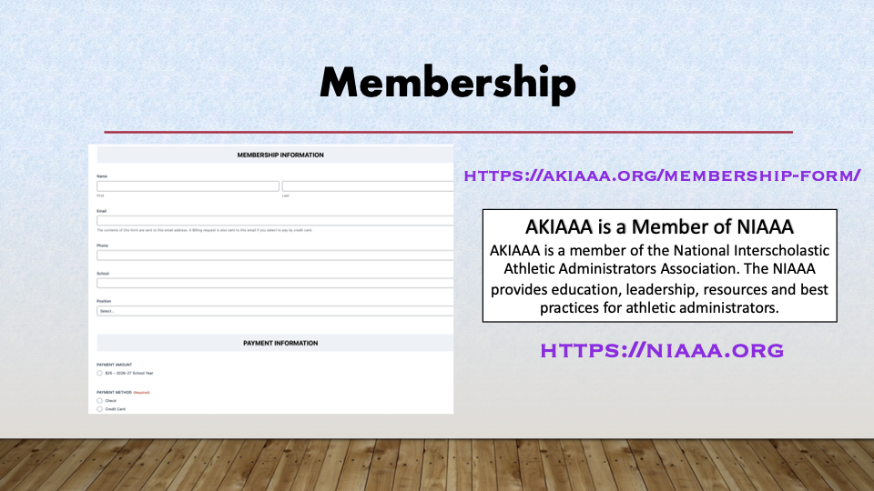
Membership
https://akiaaa.org/membership-form/
AKIAAA is a Member of NIAAA
AKIAAA is a member of the National Interscholastic Athletic Administrators Association. The NIAAA provides education, leadership, resources and best practices for athletic administrators.
https://niaaa.org

Slide 22
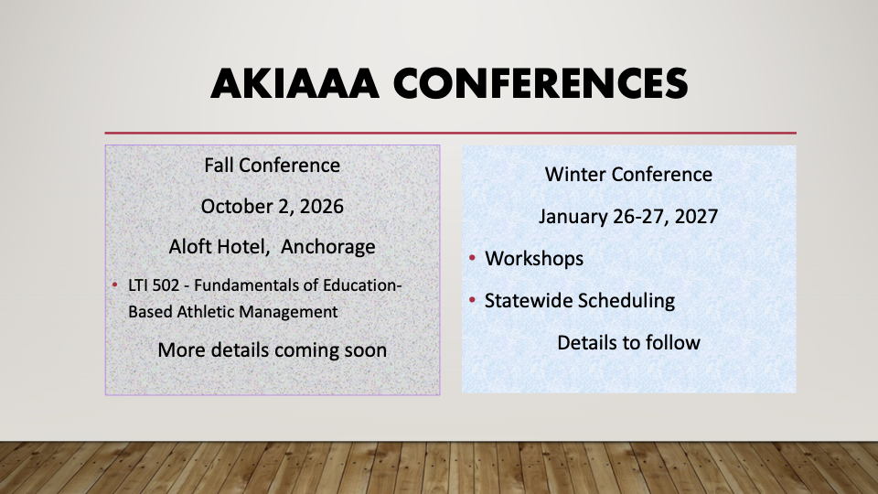

Slide 23


NIAAA
The NIAAA’s Professional Development Academy includes the Leadership Training Institute (LTI), the Certification Program, Assessment, and Educational Initiatives.

Slide 24

ESSENTIAL MUST DO’S FOR ATHLETIC ADMINISTRATORS

Slide 25
COACHES MEETING
Week of or week before activities start.
Have drinks/snacks/everything prepared.
EAP folder prepared and ready for coaches meeting.
Theme for the year.
Start with introductions, for example: name, how many years at your school, and one good thing from the summer.
Coaches goals for the season.
Thank them, show appreciate for them and their family.
Paperwork completion and expectations for coaches and participants.
Adding late athletes.
Fundraising expectations and policies to follow.
Expectations of athletes.
Expectations of coaches.
Expectations of parents.
Chain of command.
Supervision before, during, and after practice time.

Slide 26
COACHES MEETING
Putting in leave/absence.
Attendence expectations for your athletes.
Endowment fees and who pays for those games.
Gate fees/workers.
Entry fees for tournaments/meets.
Review eligibility.
Review waivers.
Review new district policies that pertain to activities.
Injury process.
Travel expectations:
  What the school pays for and what the boosters will pay for.
  Bussing/rental request.
  Review district policies on students driving.
  Flight information.
  Rosters to staff.
  Itineraries to athletes/parents/and bussing personal.

Slide 27
COACHES MEETING
Expectations for facilities and maintaining the facilities.
Schedules and where that information can be found.
Communication platform and those expectations.
Website expectations.
What to do if an athlete is removed from the team, quits the team, or is ejected.
Where they can find district and ASAA information regarding activities/their program.
Coaches immediate to-do list:
  Booster information.
  Signed code of conducts.
  Athlete/parent contract.
  Team picture.
  Fall meeting information.
  Transportation requests.
  Review fall calendar.

Slide 28
SHOW THEM APPRECIATION AND LEAVE THEM WITH INSPIRING WORDS

Slide 29
ATHLETE/PARENT MEETING
Welcome and introductions.
Celebrate and talk about your coaches in front of the athletes and parents.
Medical coverage, if any.
Celebrate last school years activity accomplishments to the group.
Grade eligibility and when grades are checked.
Participation and daily attendance at school.
Where schedules can be found.
Communication platform and expectations.
Fee payment due date.
  Payment plan.
  Athletes working it off.

Slide 30
ATHLETE/PARENT MEETING
Expectations for the athletes:
  Have athletes down front, empower them, don’t just say don’t, don’t, don’t.
  Give examples of expectations.
  Review what hazing and harassment means, give examples.
  No phones in the locker rooms—explain why.
  Social media expectations.
  Winning is important but not the most important thing.
  Talk about sportsmanship.
  Talk about what being a good teammate looks like, give examples.

Slide 31
ATHLETE/PARENT MEETING
ASAA updates:
  Policy updates.
  TAD violations and penalties.
  MSBSD—proximity rule.
Transportation updates:
  Bussing updates.
  Please be flexible and help out.
  Don’t be part of the problem, be part of the solution.

Slide 32
ATHLETE/PARENT MEETING
Parent expectations:
  Don’t be afraid of this conversation.
  Be firm but pleasant when delivering your information.
  Thank them.
  Volunteer however they can.
  Be positive spectators.
  Be flexible, understanding, and patient.
  Chain of command.
Thank the parents and athletes.
Have a closing statement.
Give your contact information.

Slide 33
GAME DAY MANAGEMENT
Safety – EAP’s
Sportsmanship (Announcements & Signage)
Positive student experiences
Community engagement
Professional operations
LTC 625 – Course with NIAAA

Slide 34
GAME DAY MANAGEMENT
(Prior to start)
Checklist
  Playing Area, Equipment, Scoreboard, Sound System, Locker Rooms, Restrooms, Bleachers, Signage, Streaming
  Officials, Visiting Team Received information, Gate Workers, Medical Coverage, Table Workers, Concessions, Security.
Be prepared for the unexpected
Have EAP ready
Communication Plan
Small Schools, sometimes you are the only administrator at the event.

Slide 35
GAME DAY MANAGEMENT
(DURING the event)
Don’t manage from your office
Be visible
Address issues early, Model expectations
  Support Coaches, Officials, Students and Parents. Never ignore unsporting behavior.
Observe:
  Crowd, Student Section, Officials, Facilities, Hallways, Restrooms, Weather
Managing the what if’s
Injuries, ejections, weather delay, power outage, equipment failure, medical emergency, spectator issue.

Slide 36
GAME DAY MANAGEMENT
(end of event)
Thank your Officials, Volunteers, Table Workers, Gate Keepers.
Visiting Teams depart safely OR housing in your building
Secure Facility
Sample Reading Prior to Game
Common Mistakes:
Not Visible
Assuming Volunteers know their jobs
Poor Communication
No emergency planning
Waiting too long to address poor behavior

Slide 37
TRAVEL & LOGISTICS
Understand your districts transportation policies. Alaska is unique.
Weather is always part of the schedule especially in the winter.
Back up plans, contact lists, flexible arrival times, alternate options (within reason)
Build strong relationships to make travel for your school and groups easier.
Good relationships may often solve problems before they become a problem.
Communicate with parents, coaches, and administration early and often

Slide 38
TRAVEL & LOGISTICS
Prepare Travel packets for your teams
Have a welcome letter for your visiting teams with pertinent information on it.
Meal planning.
Understanding school attendance impacts. Sometimes unavoidable.
Toolbox:
Sample Tournament Headquarters Doc
Sample Itinerary for Teams
Sample Visiting Team Information Sheet
Sample Group Housing Agreement

Slide 39
